Slide 1
Ensemble Learning
By Yaohang Li, Ph.D. Department of Computer Science Old Dominion University yaohang@cs.odu.edu

Slide 2
Agenda
Introduction to Ensemble Learning
Bias-Variance Tradeoff
Ensemble Learning Strategies
Bagging
Boosting
Stacking
Summary

Slide 3
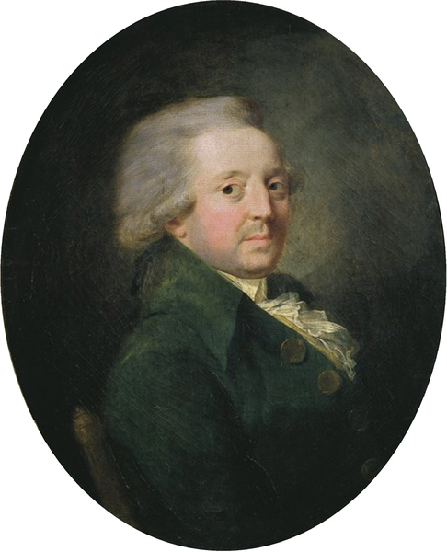
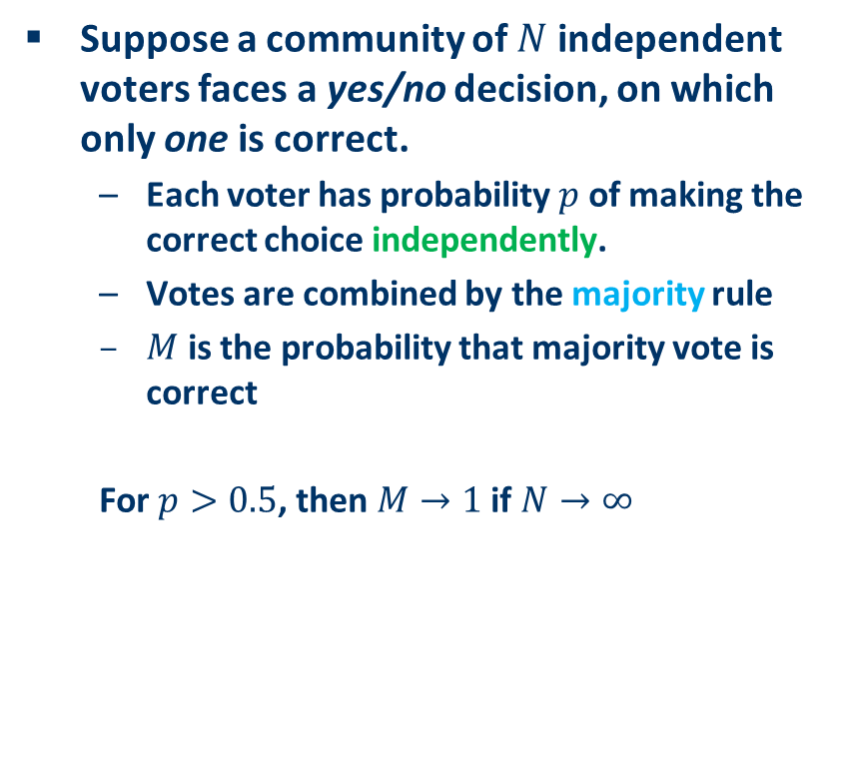
Condorcet Jury Theorem (1785)
Suppose a community of $N$ independent voters faces a yes/no decision, on which only one is correct.
Each voter has probability $p$ of making the correct choice independently.
Votes are combined by the majority rule
$M$ is the probability that majority vote is correct
For $p>0.5$, then $M→1$ if $N→∞$

Slide 4
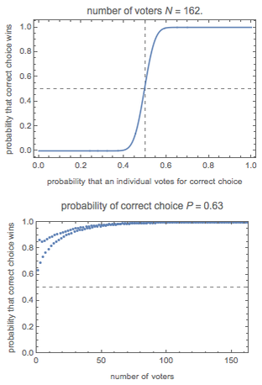
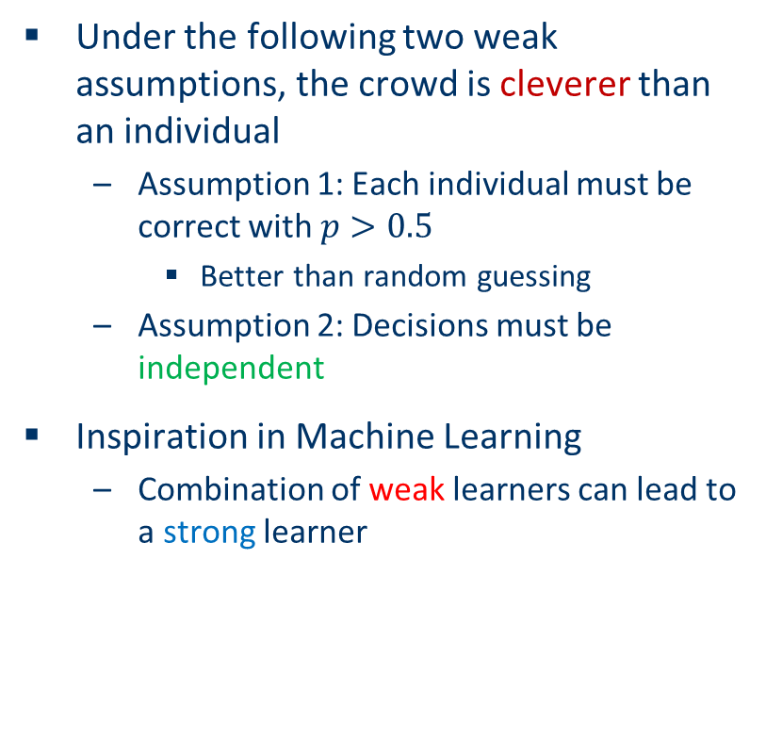
Assumptions of Condorcet Jury Theorem
Under the following two weak assumptions, the crowd is cleverer than an individual
Assumption 1: Each individual must be correct with $p>0.5$
Better than random guessing
Assumption 2: Decisions must be independent
Inspiration in Machine Learning
Combination of weak learners can lead to a strong learner

Slide 5
Weak Learners and Strong Learners
Strong Learner
A predictor which the prediction error can be made arbitrarily small
Weak Learner
A predictor which is just better than random guessing
Ensemble Learning
Instead of building a single strong predictor
Build a set of weak predictors
Combine the results from the weak predictors
To outperform the strong predictor

Slide 6
Ensemble Learning
Ensemble Learning
Develop a set of models (ensemble)
Obtained by applying a learning process to a given problem
Integrated to obtain the final prediction
Types of Ensemble Learning
Homogeneous
Using only one induction algorithm
Heterogeneous
Using different induction algorithms
Machine Learning Problems
Classification
Regression
Clustering

Slide 7
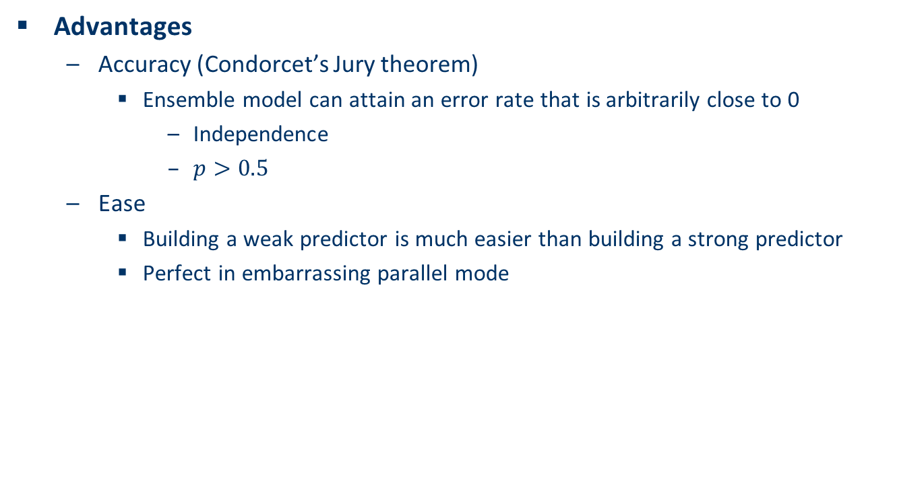
Advantages of Ensemble Learning
Advantages
Accuracy (Condorcet’s Jury theorem)
Ensemble model can attain an error rate that is arbitrarily close to 0
Independence
$p>0.5$
Ease
Building a weak predictor is much easier than building a strong predictor
Perfect in embarrassing parallel mode

Slide 8
Some Arguments
Model Combinations adds complexity
More difficult to analyze/characterize the prediction
More difficult to explain the models
Violation of Ockham’s Razor
“Simplicity leads to greater accuracy”

Slide 9
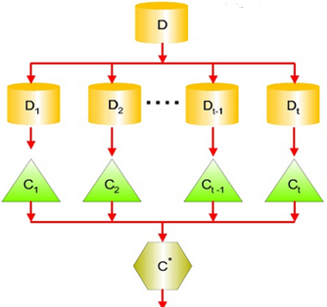
General Procedure of Ensemble Learning
Step 1
Generating multiple weak models
Step 2
Combine multiple weak models

Slide 10
Methods to Generate Ensembles
Data Manipulation
Changes the training dataset to obtain different models
Modeling Process Manipulation
Algorithm Manipulation
Generate models by different algorithms
Parameter Manipulation
Generate models by the same algorithms but different parameters

Slide 11
Data Manipulation
Feature Manipulation
Subsampling

Slide 12
Modeling Process Manipulation
Parameter Manipulation
Algorithm Manipulation

Slide 13
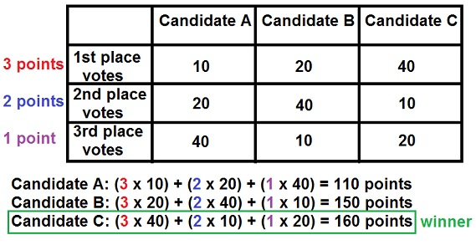
Combine Models
Algebraic Methods
Average
Weighted Average
Maximum
Minimum
Median
etc.
Voting Methods
Majority voting
Weighted majority voting
Borda count

Slide 14
Agenda
Introduction to Ensemble Learning
Bias-Variance Tradeoff
Ensemble Learning Strategies
Bagging
Boosting
Stacking
Summary

Slide 15
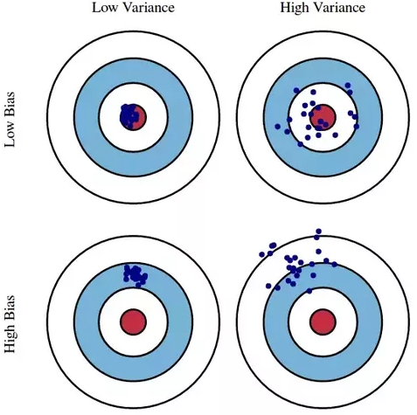
Bias Error and Variance Error

Slide 16
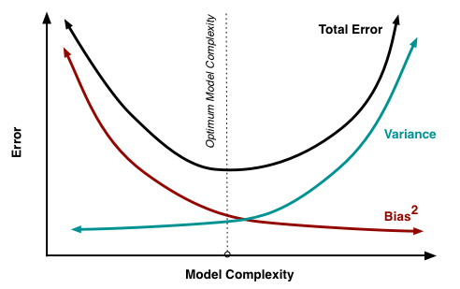
Bias-Variance Tradeoff
Bias error
From erroneous assumptions in the learning algorithm
Underfitting (Low model complexity)
High bias can cause an algorithm to miss the relevant relations between features and target outputs
Variance error
From sensitivity to small fluctuations in the training set
Overfitting (High model complexity)
High variance can cause an algorithm to model the random noise in the training data, rather than the intended outputs

Slide 17
Agenda
Introduction to Ensemble Learning
Bias-Variance Tradeoff
Ensemble Learning Strategies
Bagging
Boosting
Stacking
Summary

Slide 18
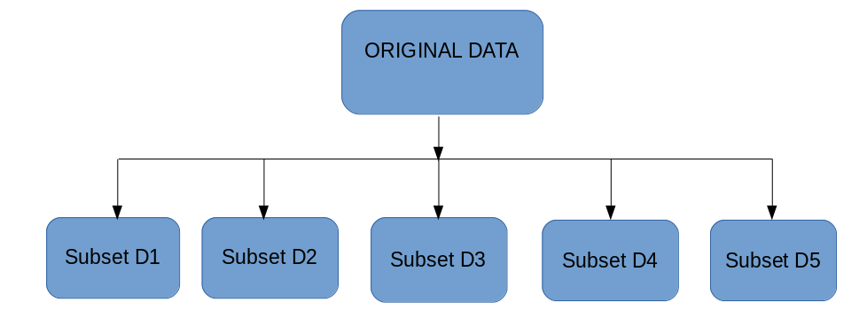
Bagging (Bootstrap + aggregating)
Bootstrap resampling
Create subsets of observations from the original dataset
with replacement
same size as the size of the original dataset
Each subset is a fair sample of the original dataset

Slide 19
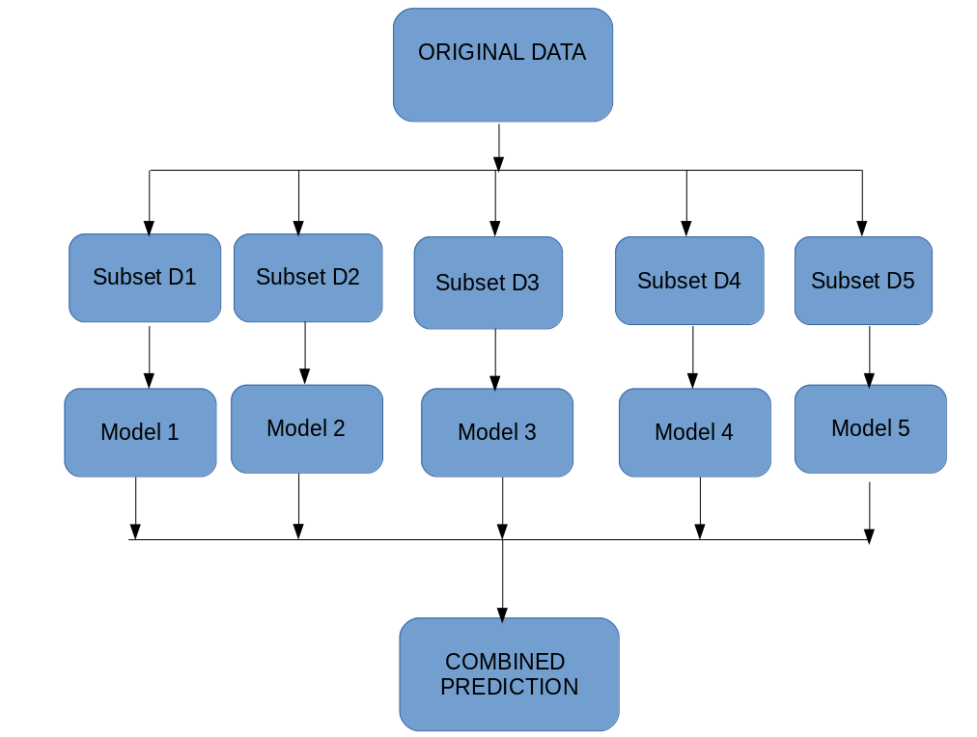
Bagging
Multiple subsets are created from the original dataset, selecting observations with replacement.
A base model (weak model) is created on each of these subsets.
The models run in parallel and are independent of each other.
The final predictions are determined by combining the predictions from all the models.

Slide 20
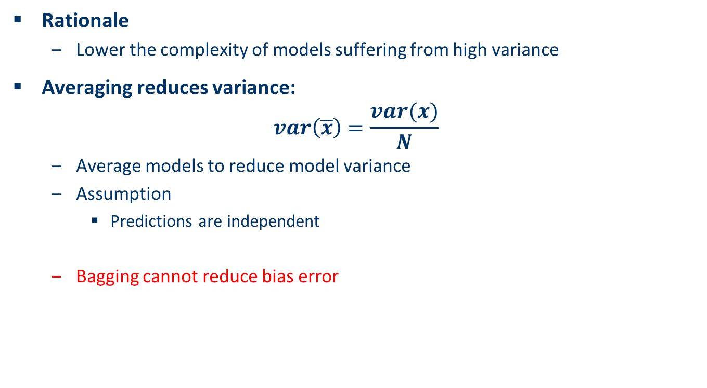
Why Bagging works?
Rationale
Lower the complexity of models suffering from high variance
Averaging reduces variance:
$$var\left(\overline{x}\right)=\frac{var(x)}{N}$$
Average models to reduce model variance
Assumption
Predictions are independent
Bagging cannot reduce bias error

Slide 21
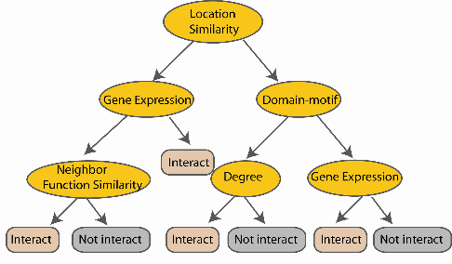
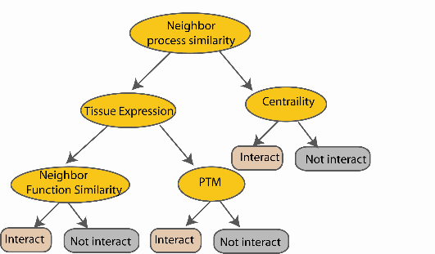
Random Forest Classifier
Bootstrap
N examples
Take the majority vote
....…
....…

Slide 22
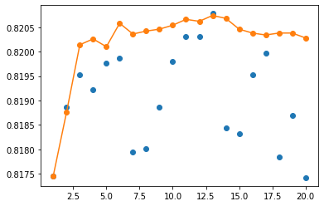
Demo: Bagging
Jupyter notebook bagging.ipynb

Slide 23
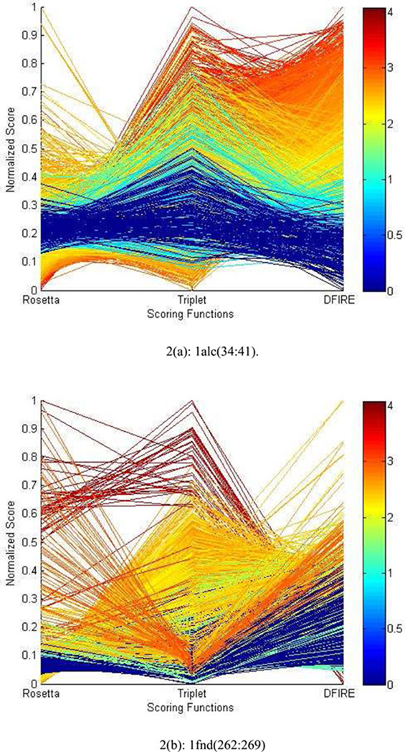
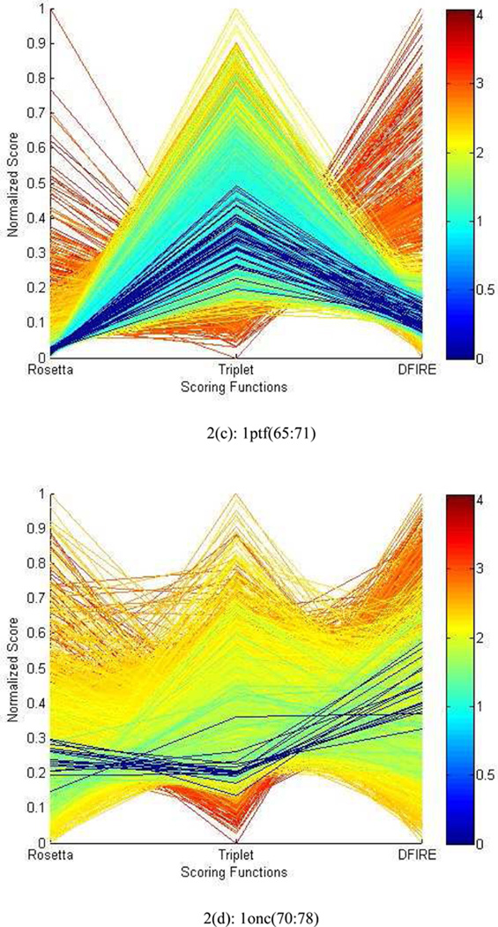
Ensemble Learning Improves Protein Loop Structure Prediction
.
.
Ensemble learning improve protein loop structure prediction to subangstrom accuracy.
Yaohang Li, Ionel Rata, Eric Jakobsson, Sampling multiple scoring functions can improve protein loop structure prediction accuracy, J. Chem. Info. Mod., 2013.

Slide 24
Agenda
Introduction to Ensemble Learning
Bias-Variance Tradeoff
Ensemble Learning Strategies
Bagging
Boosting
Stacking
Summary

Slide 25
Boosting
Rationale
Increase the complexity of models suffering from high bias
Reduce bias
Fundamental Idea
Each subsequent model attempts to correct the errors of the previous models
Individual model
Does not perform well on the entire dataset
Works well for some part of the dataset
Boosts the performance of the ensemble
from (github.com/bgreenwell/)

Slide 26
Weighting in Boosting
Sample weights
Correctly classified samples -> smaller weights
Incorrectly classified samples -> larger weights
Weighting in Boosting Algorithms
Boosting by sampling (more general)
The weights influence the sampling process
Samples with larger weights will be selected in higher chance
Boosting by weighting (works only with some learners)
Learner are influenced by sample weights
Boosting by learners
Better learner gets a larger weight
More learners, better accuracy of the combined model

Slide 27
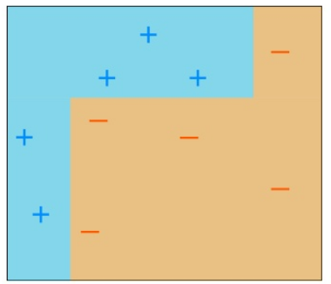
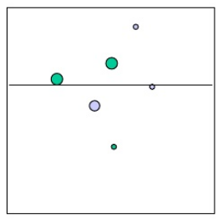
Boosting Example (Adaptive Boosting)
Two classes with 5 positive and 5 negative training samples
Two continuous features with possible decision boundary
Decision trees with depth=1 as base learner
“decision stumps”
In the case of continuous features these correspond to axis-parallel lines:
Outputs 1 on one side, -1 on the other side
Example from AdaBoost Tutorial

Slide 28
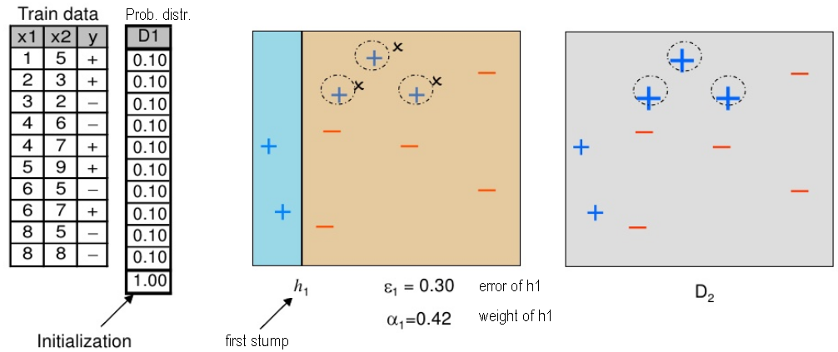
Boosting Procedure (Base Model)
Initialize with equal weights (D1)
A subset is created from the original dataset according to prob. dist. D1
Train a base model with first stump is created on this subset.
Increase the weight of the missed samples to prob. dist. D2
Three misclassified + points are given higher weights
Weak Learner

Slide 29
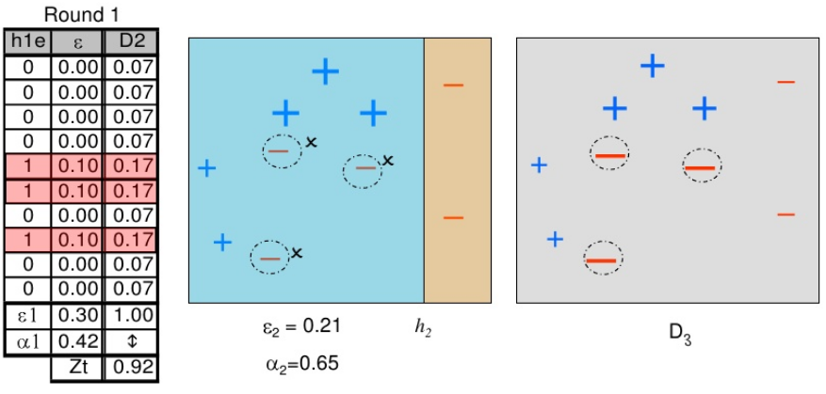
Boosting Procedure (Subsequent Models)
Sample the data using the new weights D2
Train the second stump and calculate its error and combination weight
increase the weights of the missed samples →D₃
Subsequent model tries to correct the errors from the previous model
Three misclassified - points are given higher weights

Slide 30
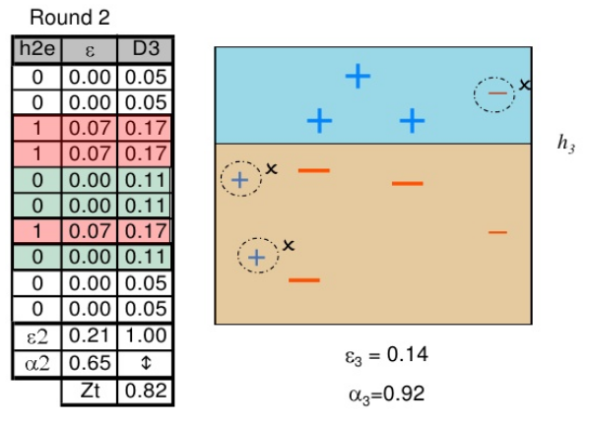
Boosting Procedure (Subsequent Models)
Sample the data using the new weights D₃
Train the third stump and calculate its error and weight
Stop because the combined error became 0

Slide 31
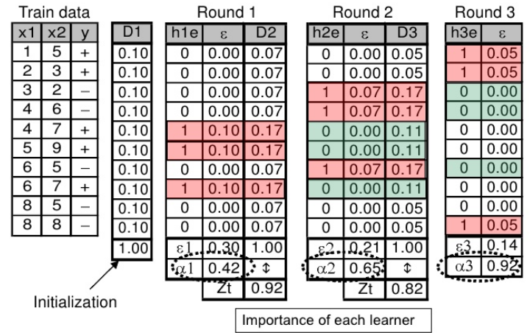
Boosting Procedure (Integration)
Integration
Multiple models are created
Each corrects the errors of the previous model.
Calculate weighted mean of all the models.

Slide 32
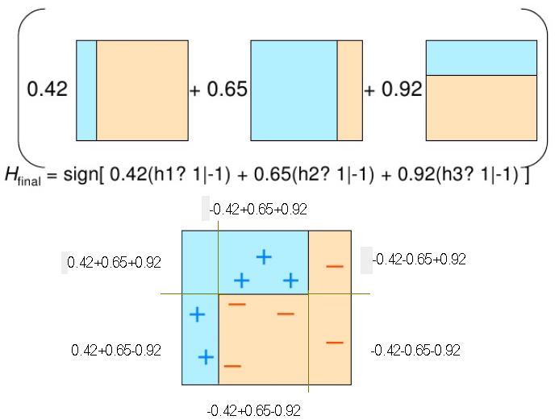
Boosting Procedure (Final Model)
Combine the 3 stumps using their weights to build the final model.
Strong Learner

Slide 33
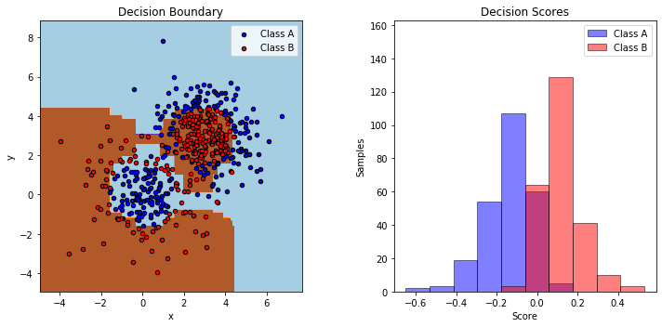
Demo: AdaBoost
Jupyter notebook adaboost.ipynb

Slide 34
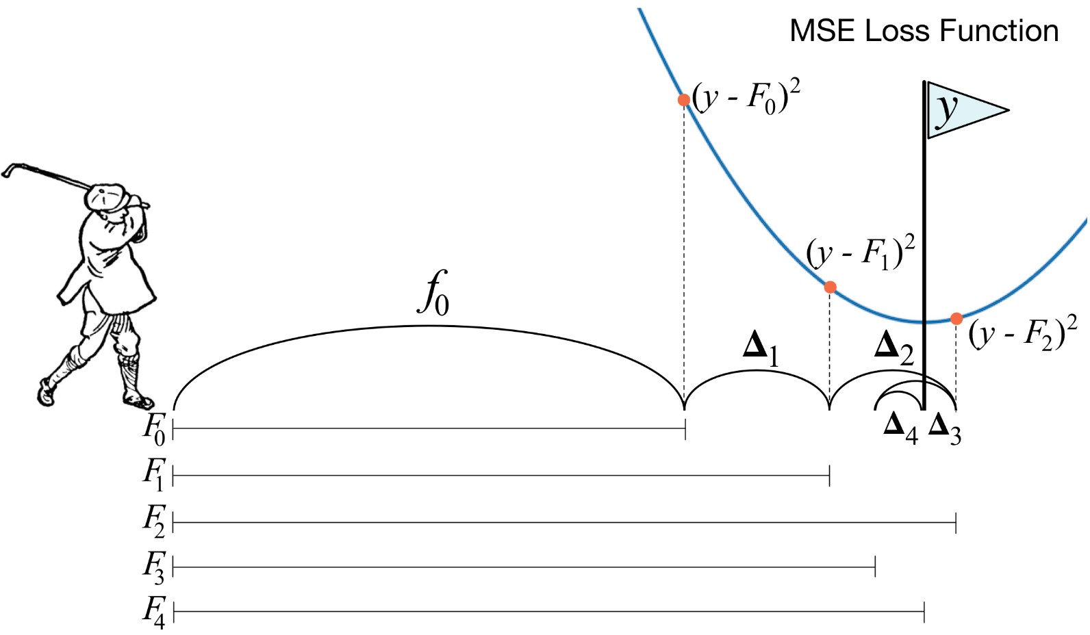
Gradient Boosting
Fundamental idea
A Greedy Algorithm
Treat boosting problem as an optimization problem
Set up a loss function
Optimize the loss

Slide 35
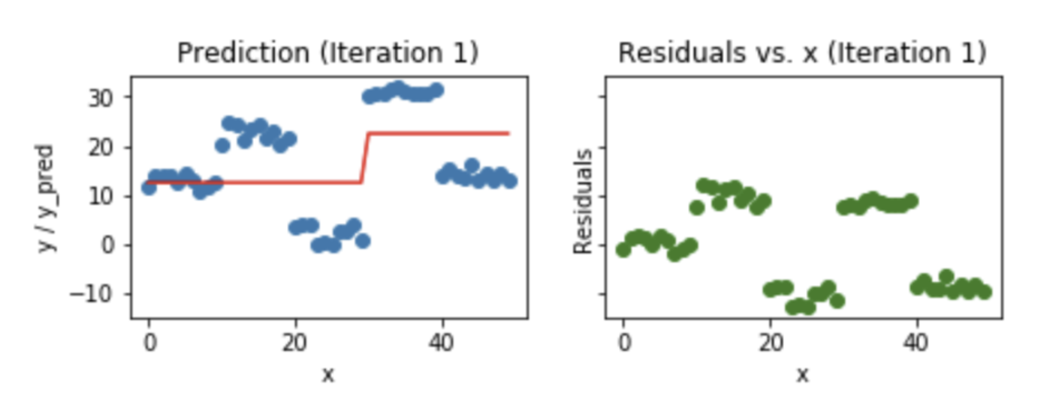
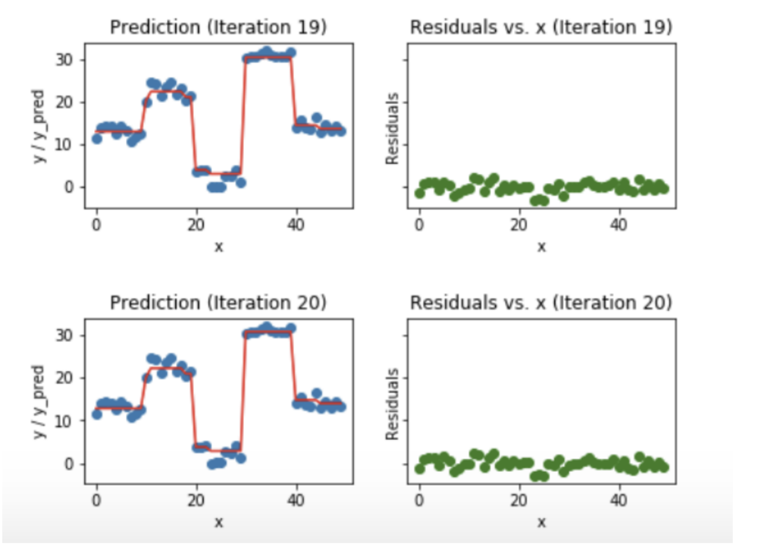
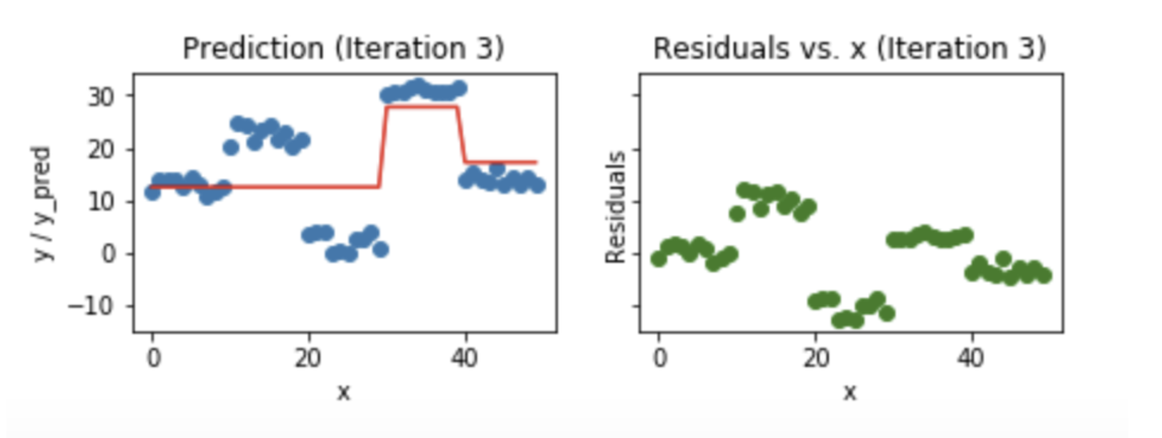
Gradient Boosting Example
Iteration 1: A weak model and residual error
Iteration 20: All residual error goes down to nearly 0.
Iteration 3: A new weak model to focus on areas the existing learners are performing poorly (high residual error)

Slide 36
Gradient Boosting Improvements
Disadvantages
A greedy algorithm
Overfit a training dataset quickly
Improvements
Fundamental idea
Keep the weak learners weak (maintaining their skills)
Tree constraints
More trees, limited depth, limited number of nodes
Random subsampling
Each learner learns from a subset of the data
Penalized learning
L1 regularization
L2 regularization

Slide 37
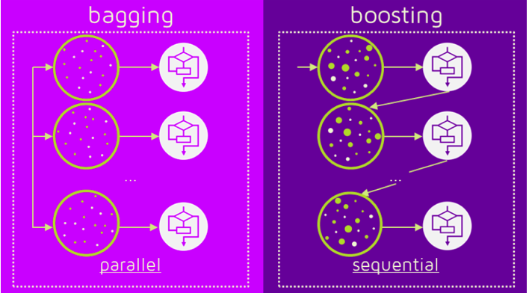
Bagging vs. Boosting
Bagging
Reduce Variance Error
Cannot Reduce Bias
Boosting
Early iterations
Reduce Bias Error
Later iterations
Reduce Variance Error

Slide 38
XGBoost (Extreme Gradient Boosting)
XGBoost is an implementation of Gradient Boosting Machines (GBM) with major improvements
Regularization: Penalize complex models through both L1 and L2 regularization in preventing overfitting.
Handling sparse data: Can incorporates a sparsity-aware split finding algorithm to handle different types of sparsity patterns in the data
Weighted quantile sketch: Can incorporate a distributed weighted quantile sketch algorithm to effectively handle weighted data
Block structure for parallel learning: Can make use of multiple cores on the CPU by a block structure in its system design
Cache awareness: Designed to make optimal use of hardware by allocating internal buffers in each thread, where the gradient statistics can be stored
Out-of-core computing: Optimize the available disk space and maximizes its usage when handling huge datasets that do not fit into memory

Slide 39
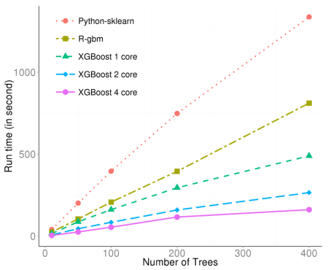
XGBoost in CERN (European Organization for Nuclear Research)
Classify signals from Large Hadron Collider
Challenges
Scalable
Process data being generated at the rate of 3 petabytes per year
Sensitive
Distinguish an extremely rare signal from background noises
XGBoost emerged as the most useful and robust solution
Machine Learning Wins the Higgs Challenge, By ATLAS Collaboration, 20th November 2014

Slide 40
Agenda
Introduction to Ensemble Learning
Bias-Variance Tradeoff
Ensemble Learning Strategies
Bagging
Boosting
Stacking
Summary

Slide 41
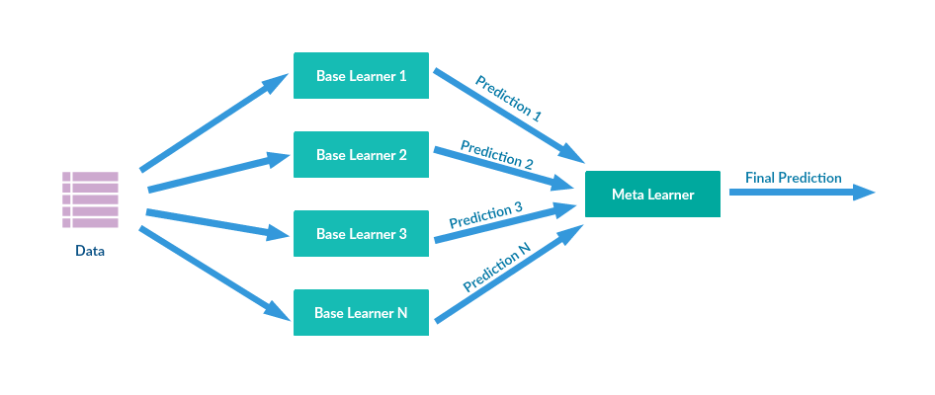
Stacking
Stacking (a.k.a. Blending)
A new model is trained from the combined prediction outputs of previous models (two or more)

Slide 42
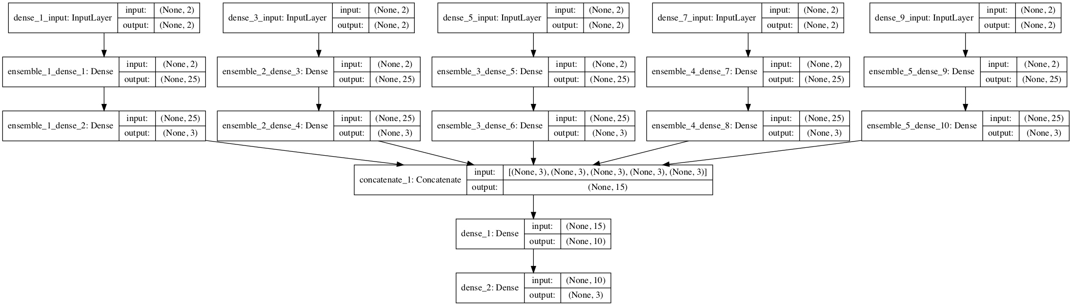
Demo: Stacking
Jupyter notebook stacking.ipynb

Slide 43
Discussion on Stacking
Stacking can be used to integrate
Homogeneous leaners
Different parameters
Heterogeneous learners
E.g. SVM + Random Forest + KNN + Logistic Regression + NN
Discussions
Adding a strong classifier does not guarantee to improve
Adding a weak classifier may be helpful
Need to test different combinations

Slide 44
Summary
The idea behind ensemble learning
The power of weak learners
Dilemma of Bias and Variance
Bagging helps in reducing variance
Boosting helps in reducing bias and variance

